Slide 1
Training Management System
Jubayer Bin Hedayet-30060

Slide 2
TABLE OF CONTENTS
01
Project Summary
02
Feature List
Fully describe the whole project in summary
List of Feature are given there
Technologies and Tools
Screenshots and UI
03
04
Details discussion on technologies and tools
Given all screenshots for UI
Learning From This Project
Challenges
05
06
Discuss about learning this project
Discuss about challenges and how to solve this problem

Slide 3
Project Summary
TMS acts as a centralized hub. Here there is 3 role admin, trainee, trainer.Admin , as primary users, oversee and manage the system, performing administrative tasks and configuring the TMS. Trainers, as subject matter experts, track participant progress. Trainees, the program participants, enroll inbatch, access materials, and complete assignments. Trainers and trainee may communicate with themselves through ClassRoom.
Admin has also accessed to give any message through notice board.
Notes:
The Training Management System (TMS) is an advanced and comprehensive software application meticulously designed to revolutionize the way training programs are managed within organizations. With its cutting-edge capabilities, the TMS acts as a centralized hub, seamlessly integrating all aspects of training management into a single, cohesive platform.

Slide 4
Feature List
Admin
Trainer
Trainee
Register trainee and trainer
Update admin profile
Create course and delete update
Create batch and assign trainee and schedule to the batch , also he can remove
He can see classroom post comment and give a notice for the specific batch
Trainer can see profile and update It
Trainer can create assignment and evaluate it.
Trainer can create post and comment, he can update and delete it.
He can give notice.
Trainee Can See their
Profile and update it
Trainee Can submit their assignment
Trainee can create comment for specific post, he can delete it also.

Slide 5
Technology And Tools
Development Environment
DataBase
Framework and libraries
Intellij IDEA
MySQL
Spring MVC and React.js
Testing
Unit Testing- Mockito

Slide 6
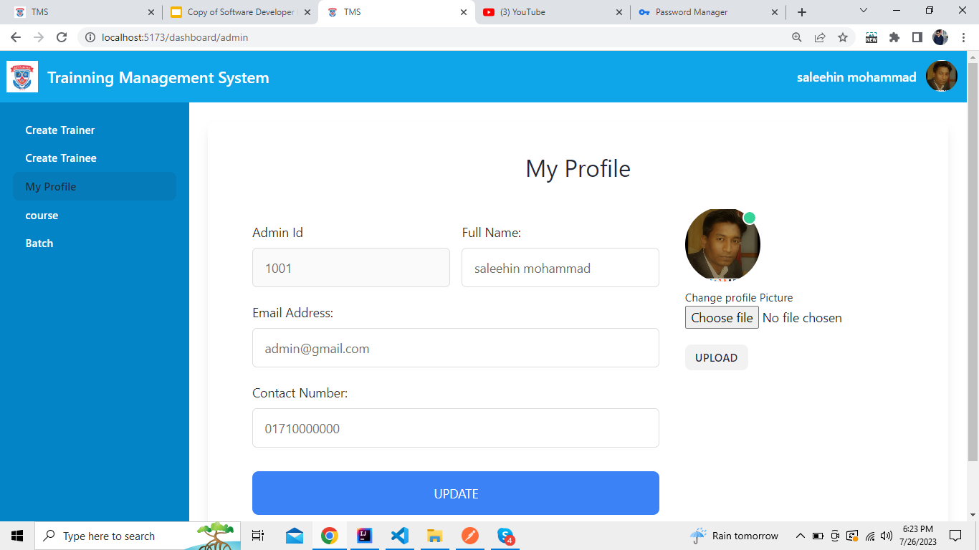

Slide 7
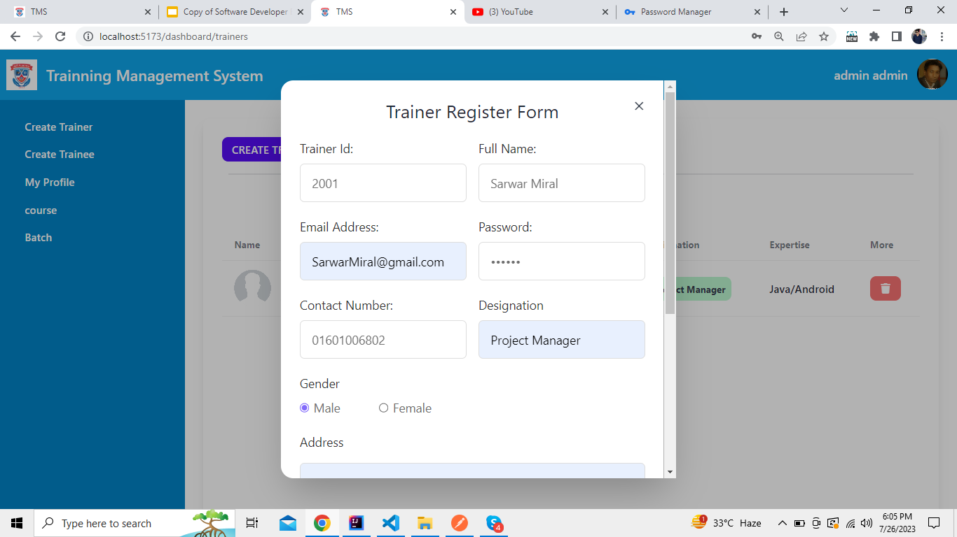

Slide 8
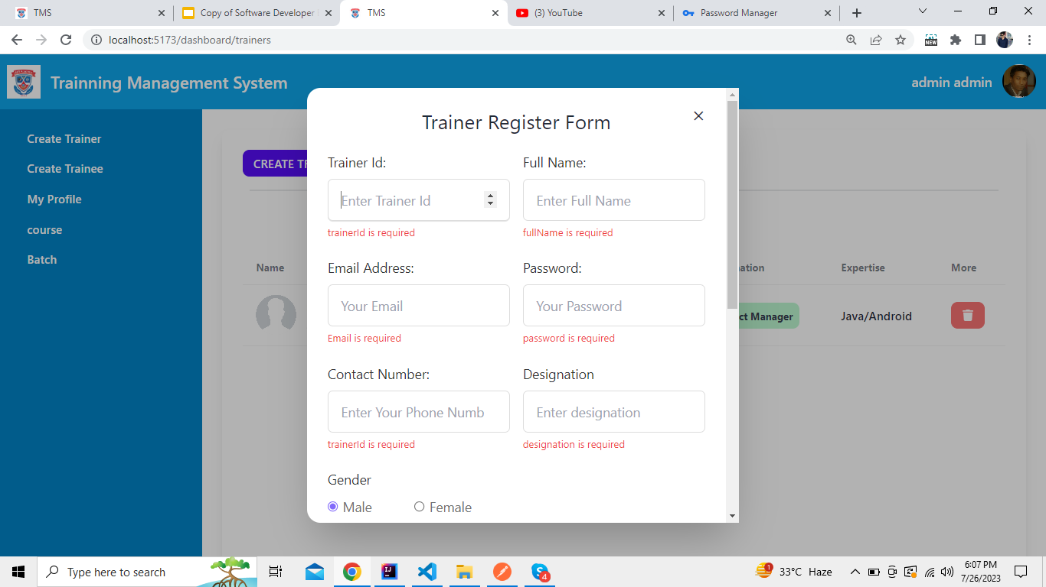

Slide 9
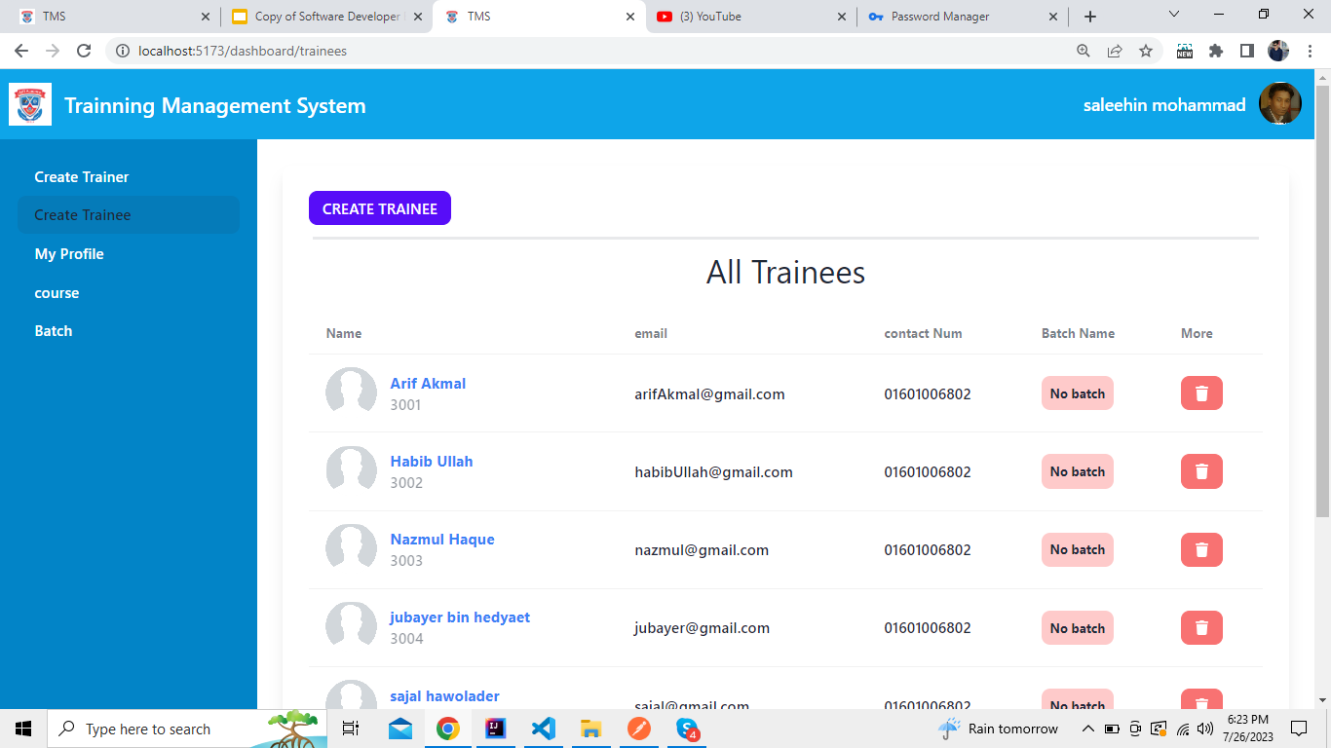

Slide 10
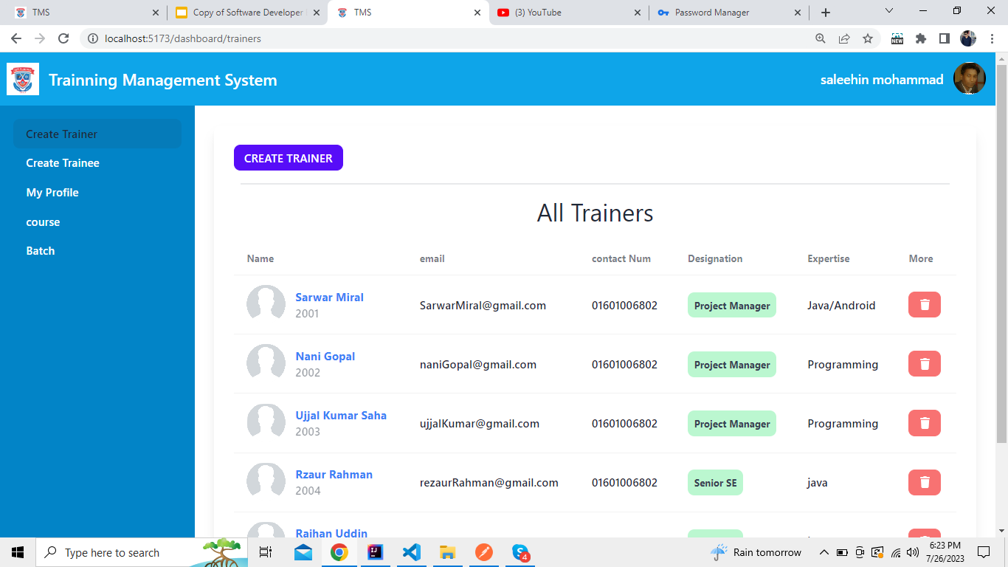

Slide 11
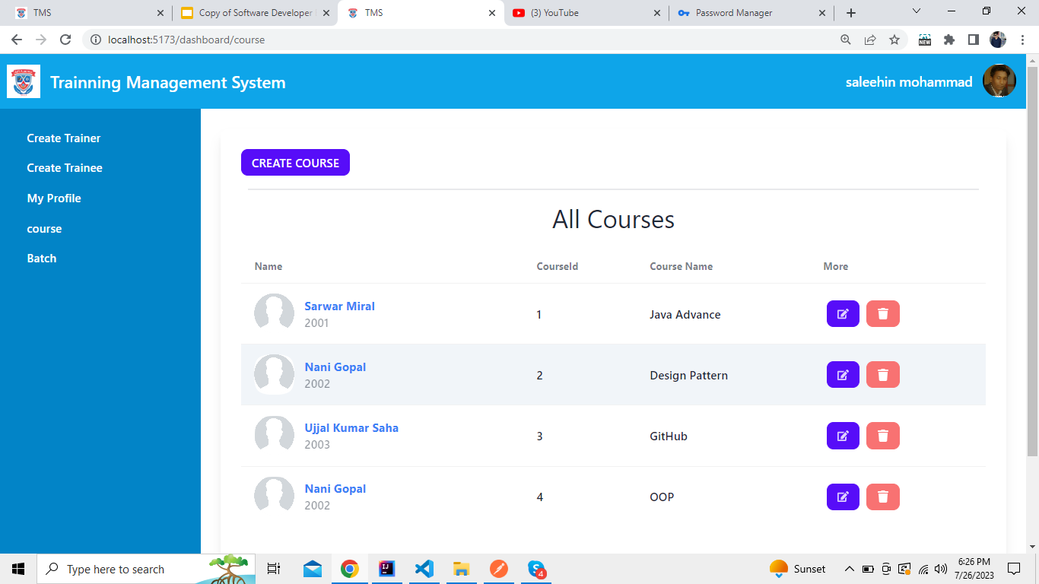

Slide 12
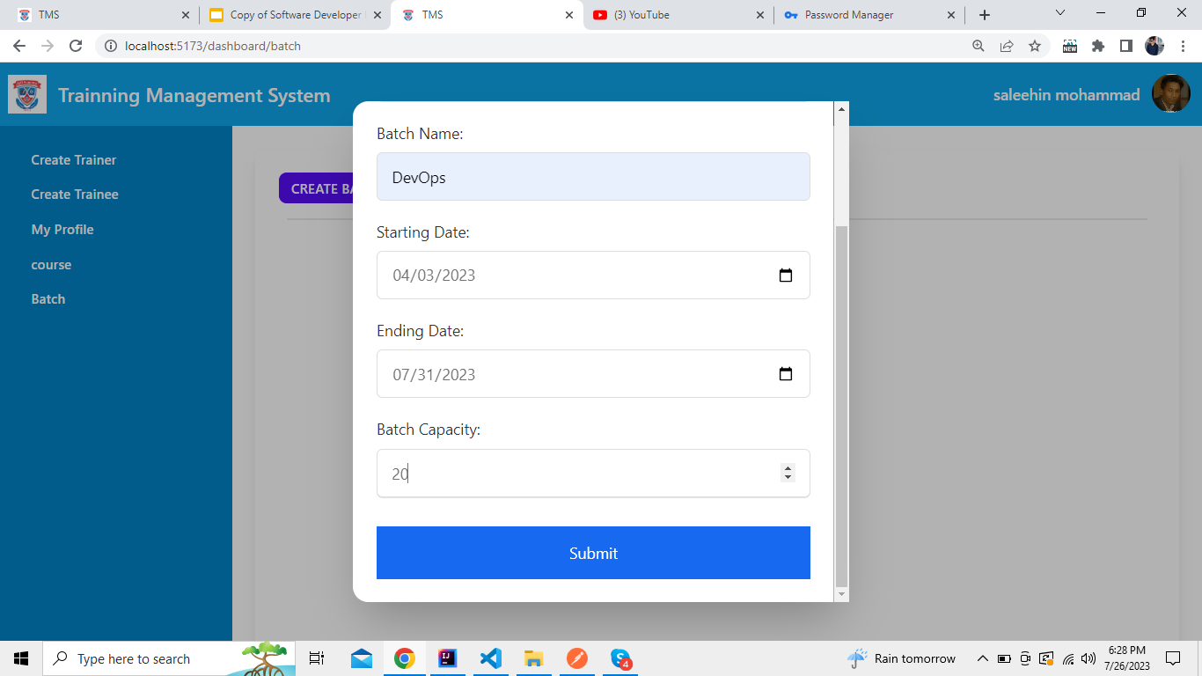

Slide 13
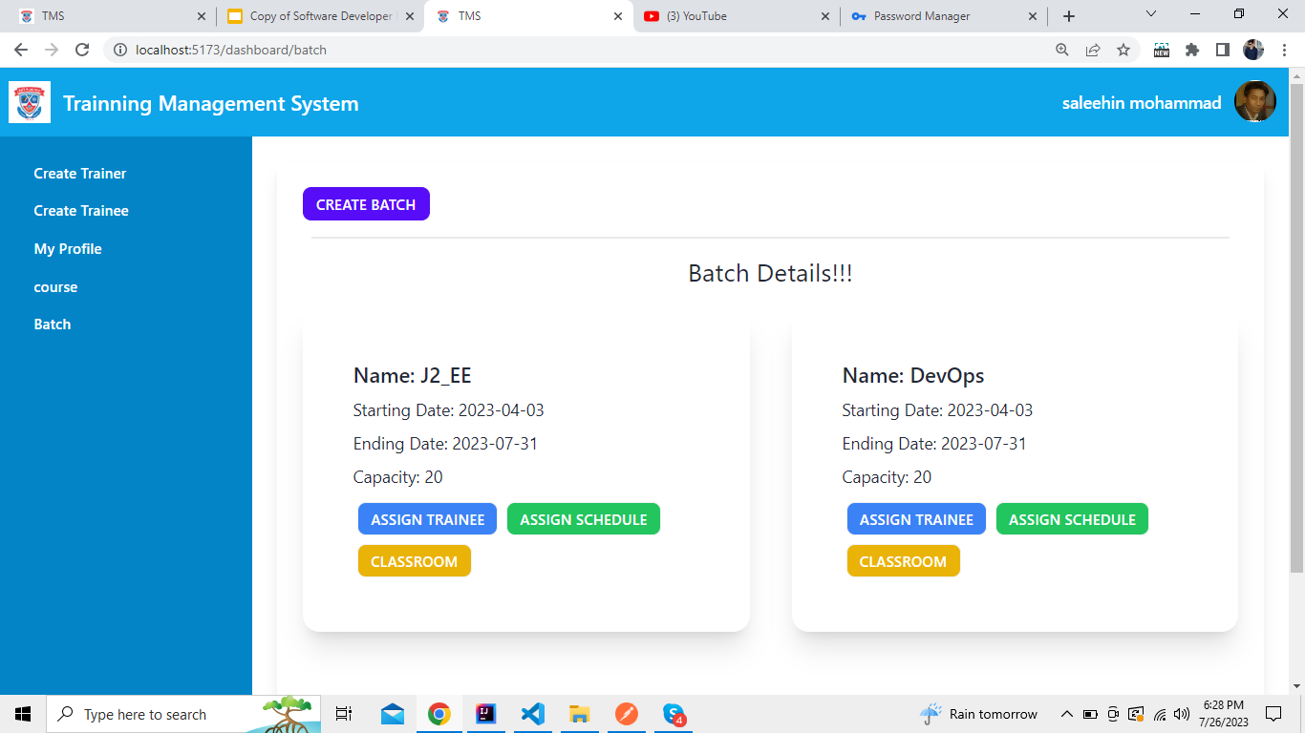

Slide 14
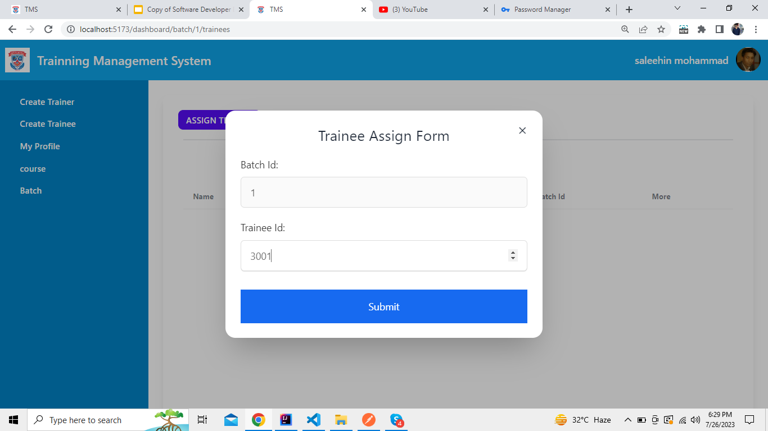

Slide 15
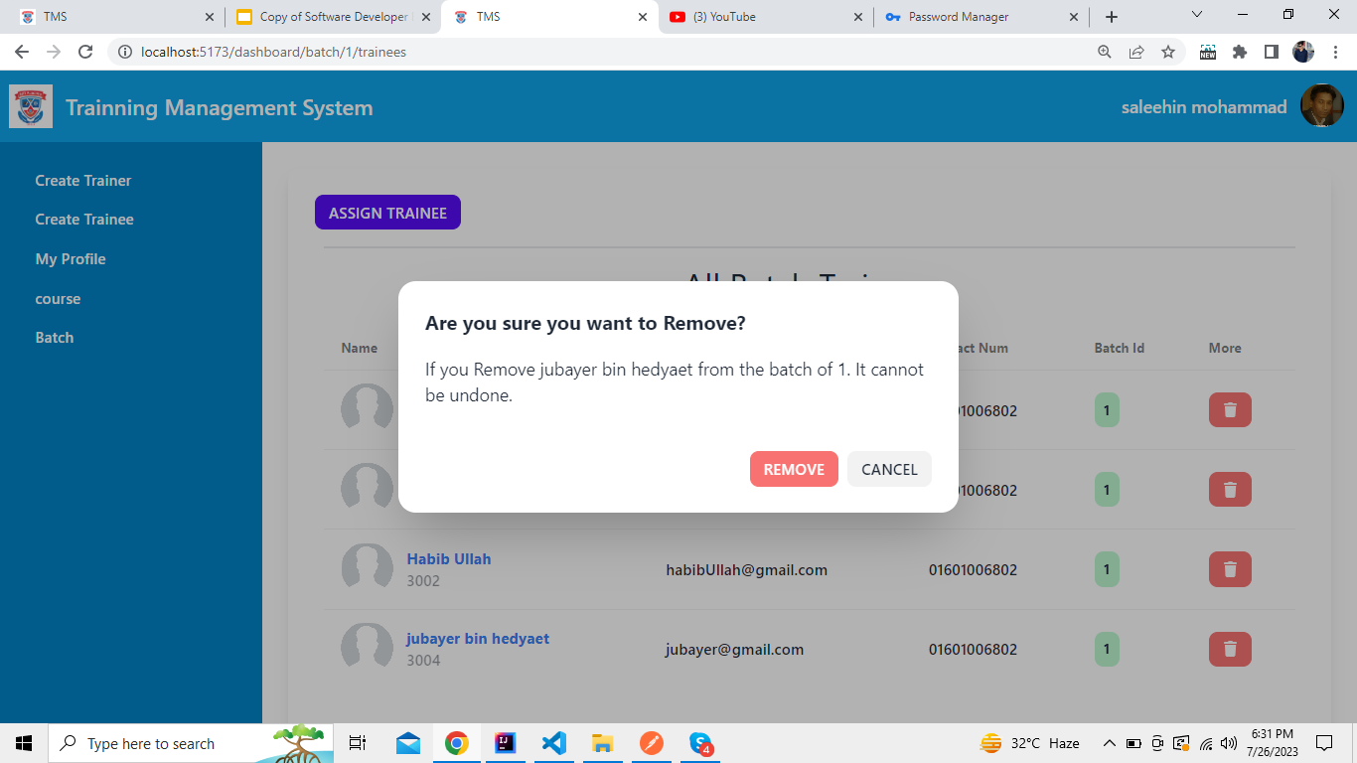

Slide 16
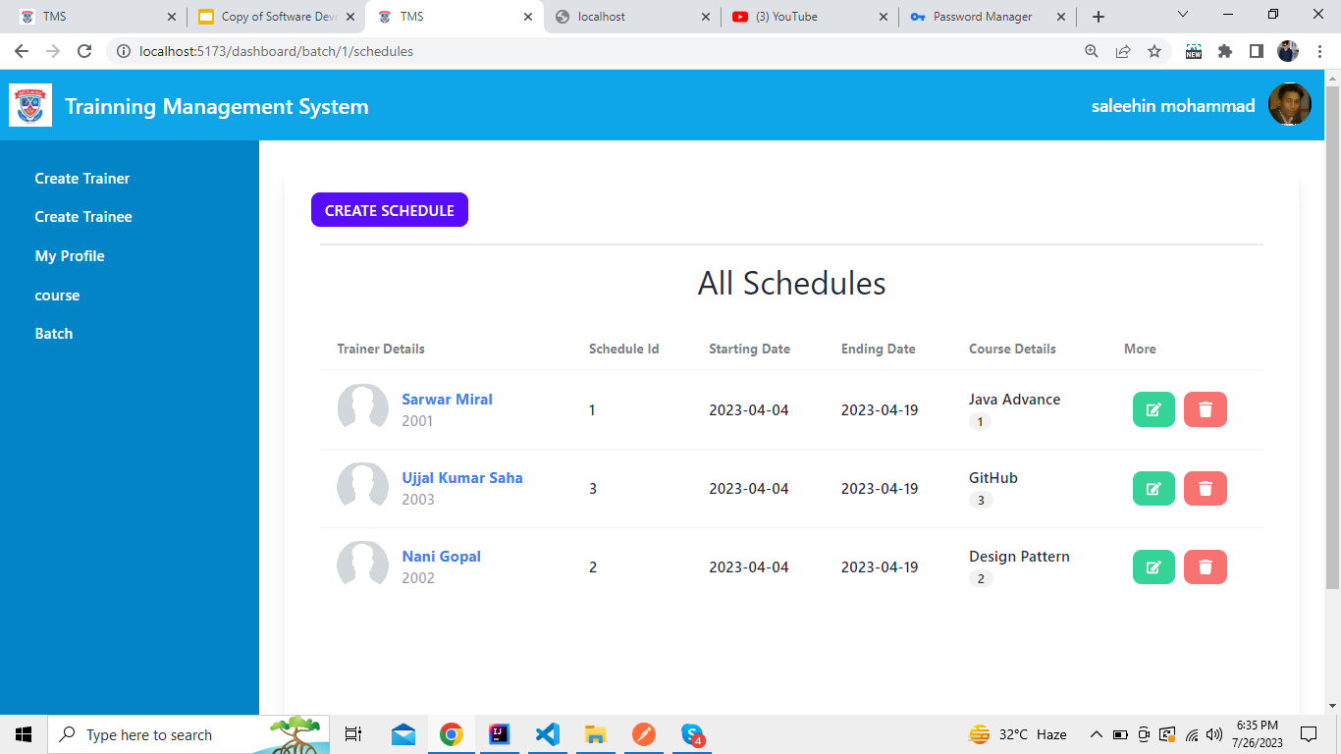

Slide 17
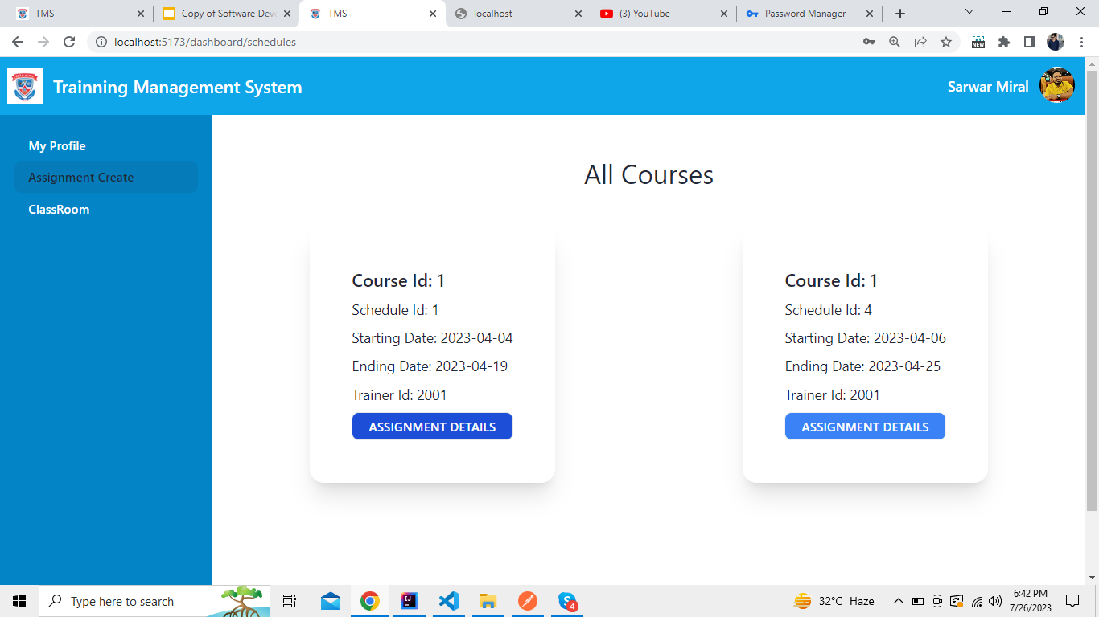

Slide 18
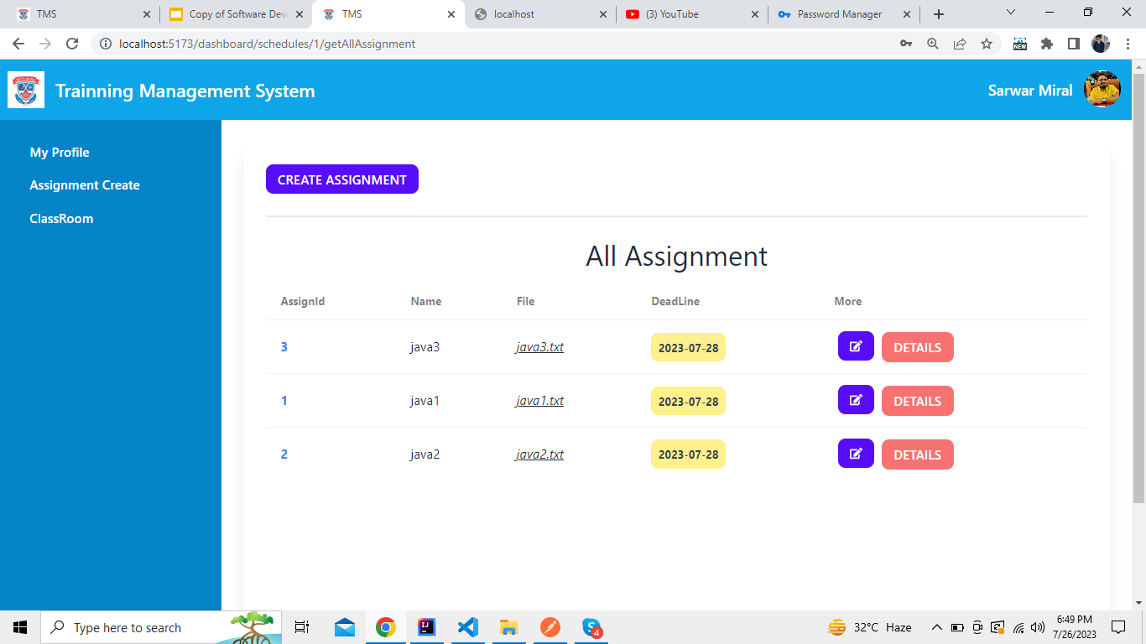

Slide 19
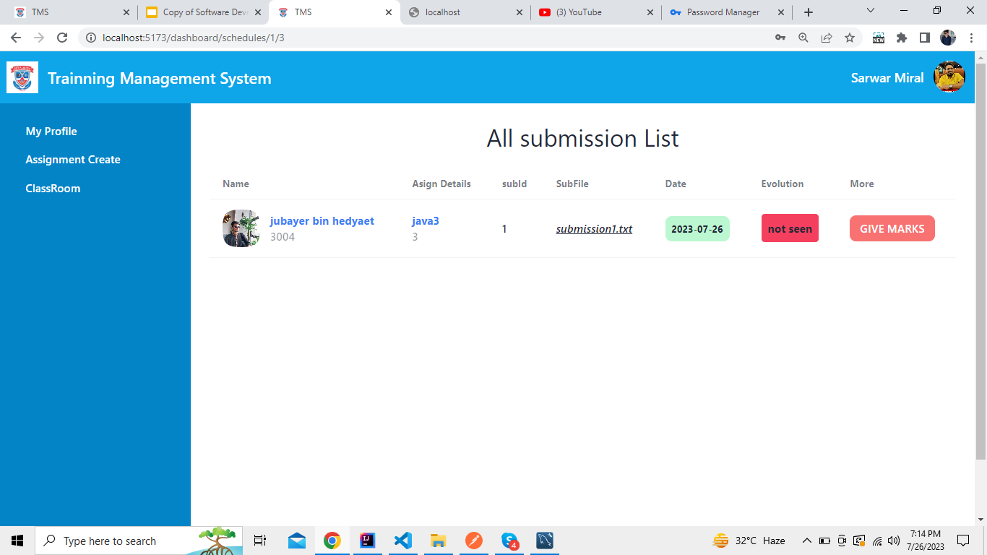

Slide 20
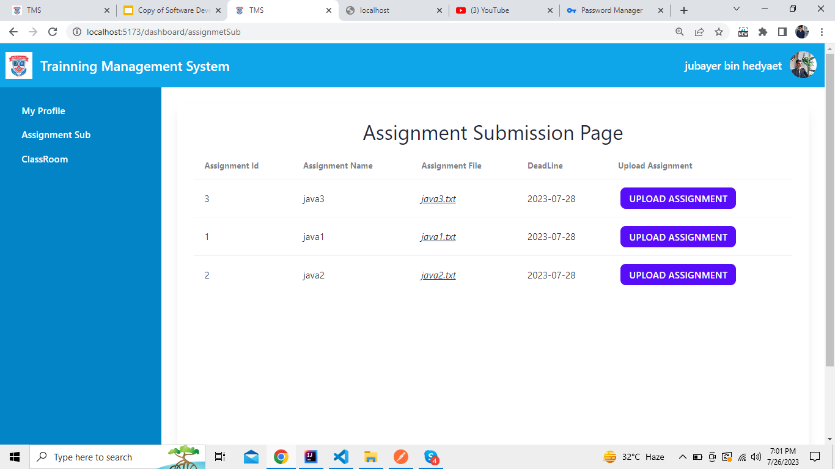

Slide 21
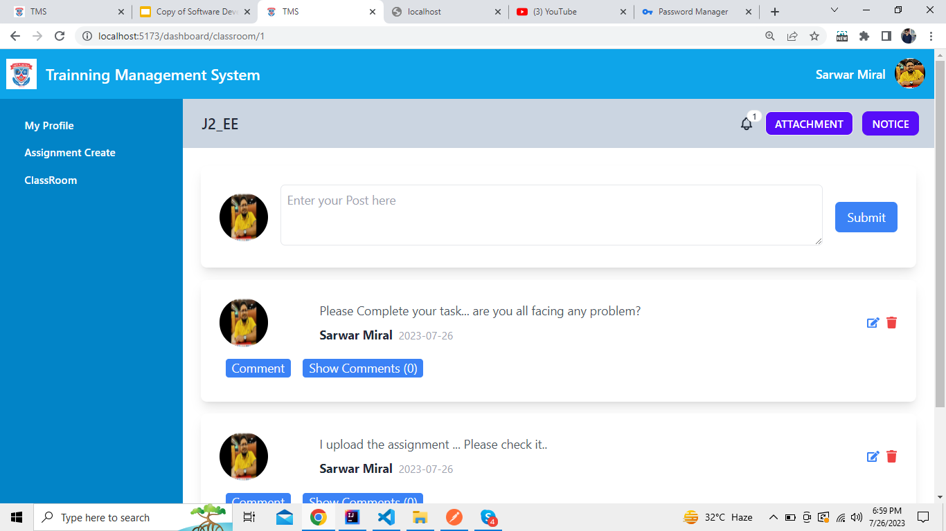

Slide 22
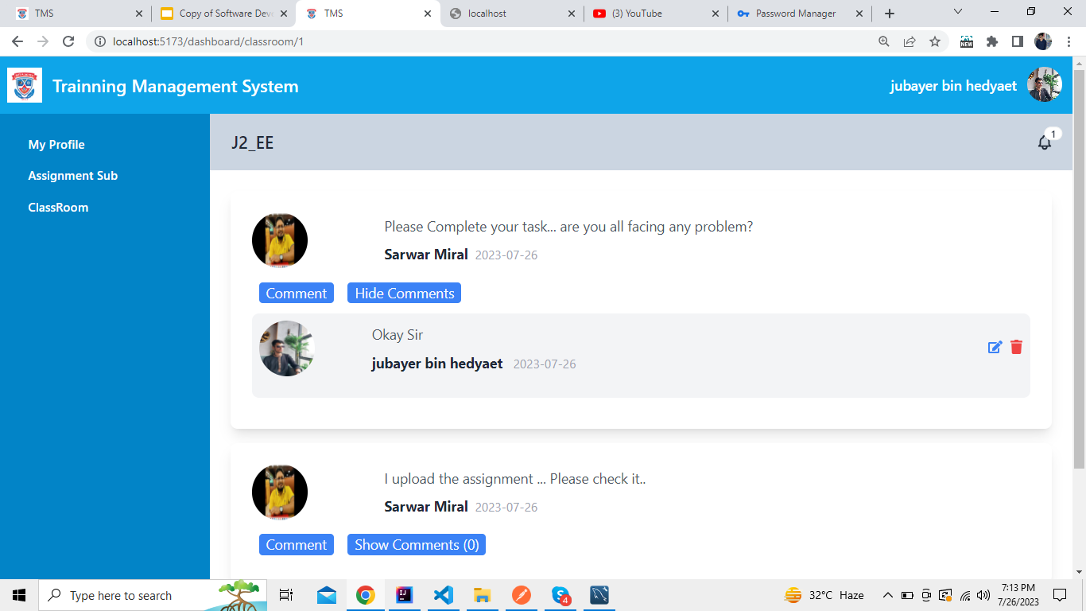

Slide 23
My Learning From This Project
Understanding User Needs
Technical Expertise
Project Management
Security and Compliance
Project
Learning
Gain a deep understanding of the diverse needs of administrators, trainers, and trainees
Project provides an opportunities to enhanced technical skills
Managing a TMS project involves coordinating various tasks, timelines, and stakeholders
Learns about security best practices and how to protect user data from potential threats

Slide 24

Challenges And how to solve this
Challenge
ClassRoom UI For 3 roles in same page
Solve
Role Checking for every users and if the role is match for access then it will show for this user otherwise he can not see it.

Slide 25
Enhancement proposal
Adding attendance for the trainees.

Slide 26
THANKS!
Do you have any questions?
youremail@freepik.com
+91 620 421 838
yourwebsite.com
Please keep this slide for attribution

